Slide 1
High-fidelity Prototype
Group K
Qihang Wang - 33026459
Ziqi Pei -33429472
Yixiang Zhang - 32774494
Zewen Gu -29246237

Slide 2
Outline
Qihang Wang
User stories - Introduction
Home Page and filter Page
Voice Control page (accessibility)
Zewen Gu
Job Searching and View Detail Page
Ziqi Pei
Apply for job and favourite (My Job) Page
Yixiang Zhang
Notification and Account Page
Zewen Gu
Conclusion and Suggestions
With related design principles and accessibility guidelines
Notes:
This is our outline. So we have already got some pages like homepage, … done by now. Firstly we will briefly talk about our user stories, And next we will demonstrate these along with the corresponding design principles that applied to them.

Slide 3
User Stories
As Rose, I want to connect with people who has no experience of raising dogs, so that I can help them with any dog-related problems. – (job searching)
As Alex,I would appreciate in-app messaging and notifications This will ensure that i receive timely updates event details and communication from organisers,allowing me to stay informed and engaged with my volunteering commitments. – (notification)
As Jason, I want to connect with those who have psychological issues so that I can help them with any psychological issues they have. – (accessibility)
Notes:
So the reason why we are going to build our high-fidelity prototypes is because we have such user stories in our previous design, as you see they mainly focus on different functions like job searching, notification and accessibility. So in order to give our user the ideal user journey, we are continuing work onto our design.

Slide 4
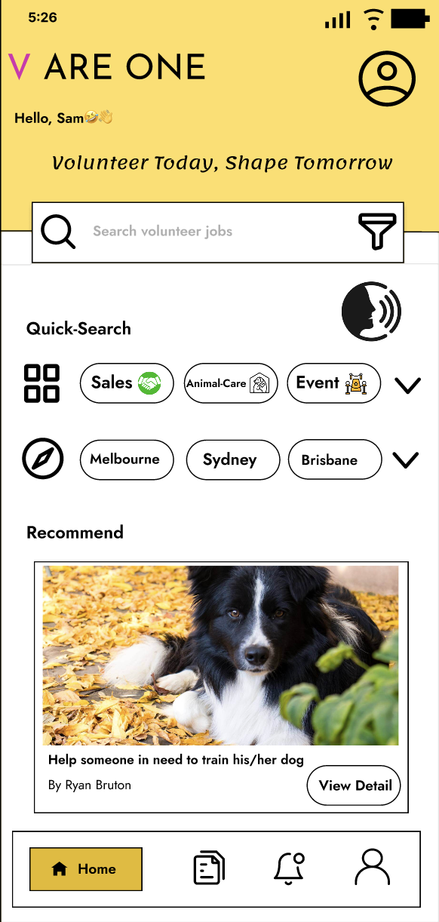
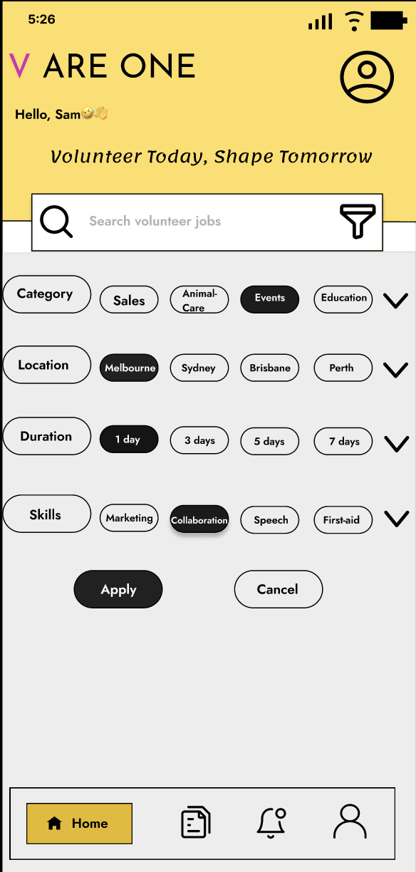
Home page

Slide 5
Design Principles
Norman's Design Principles - visibility
Norman's Design Principles - mapping
Norman's Design Principles - feedback
Shneiderman’s 8 Golden Rules - keep users in control
Shneiderman’s 8 Golden Rules - offer informative feedback
Notes:
Visibility - Can I see it?
Mapping - Where am I and where can I go?
Feedback - what am I doing now?

Slide 6
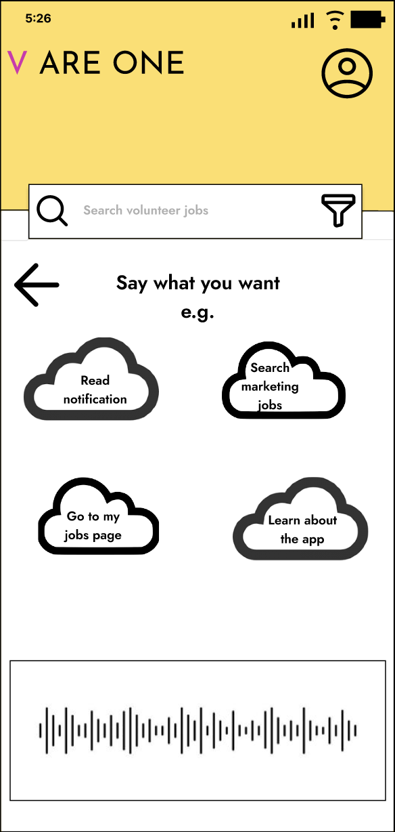
Accessibility guideline
WCAG Principle: Perceivable
WCAG Principle: Operable
WCAG Principle: Understandable
Notes:
Perceivable: perceivable information and user interface
● Text alternatives for non-text content.
● Captions and other alternatives for multimedia.
● Content can be presented in different ways.
● Design content that is easy to see and hear.
● UI controls should have text labels that describe their purpose. Example: Captions provided for live audio content.
Key point: Can users use their available senses to detect the content?
Operable : Users can easily navigate and determine where they are. ● Users can use different input modalities beyond keyboard.
Key point: Can users execute the required interactions easily?
Understandable information and user interface ● Text is readable and understandable. ● Content is presented in predictable ways. ● Navigation and controls work in predictable ways. ● Users are helped to avoid and correct mistakes.

Slide 7
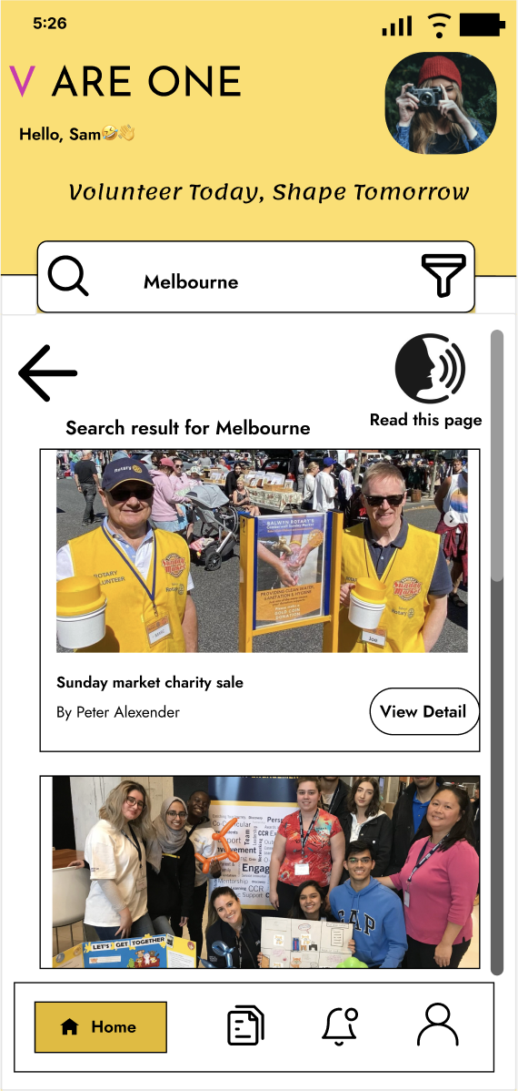
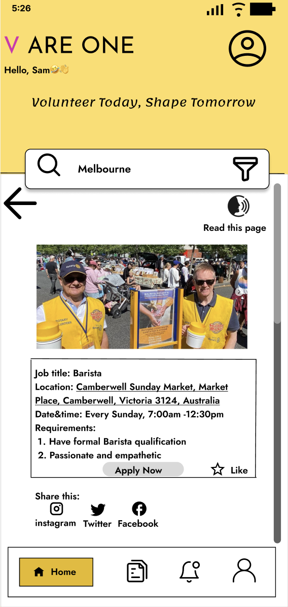
Search volunteer jobs and view job details

Slide 8
Design Principles
Shneiderman’s 8 Golden Rules - keep a consistent a familiar design
Shneiderman’s 8 Golden Rules - design for users with different abilities
Shneiderman’s 8 Golden Rules - Offer Informative Feedback
Shneiderman’s 8 Golden Rules - Reduce Short-term Memory Load

Slide 9
Accessibility guidelines
WCAG Principle: understandable
WCAG Principle: perceivable
WCAG Principle: operable

Slide 10
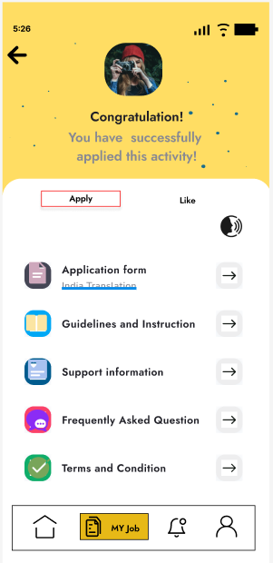
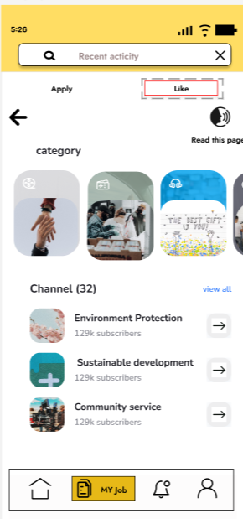
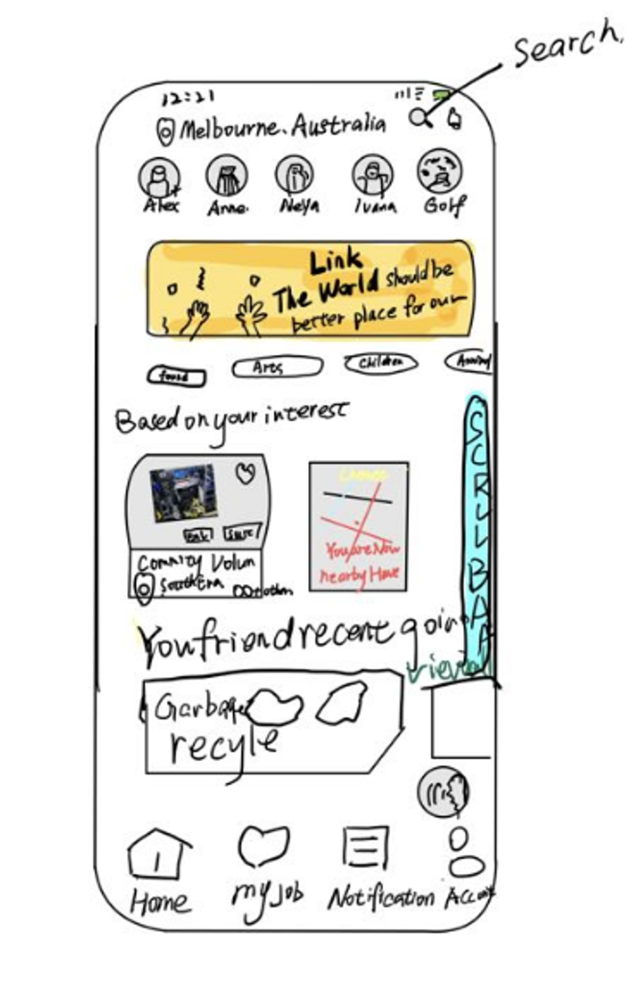
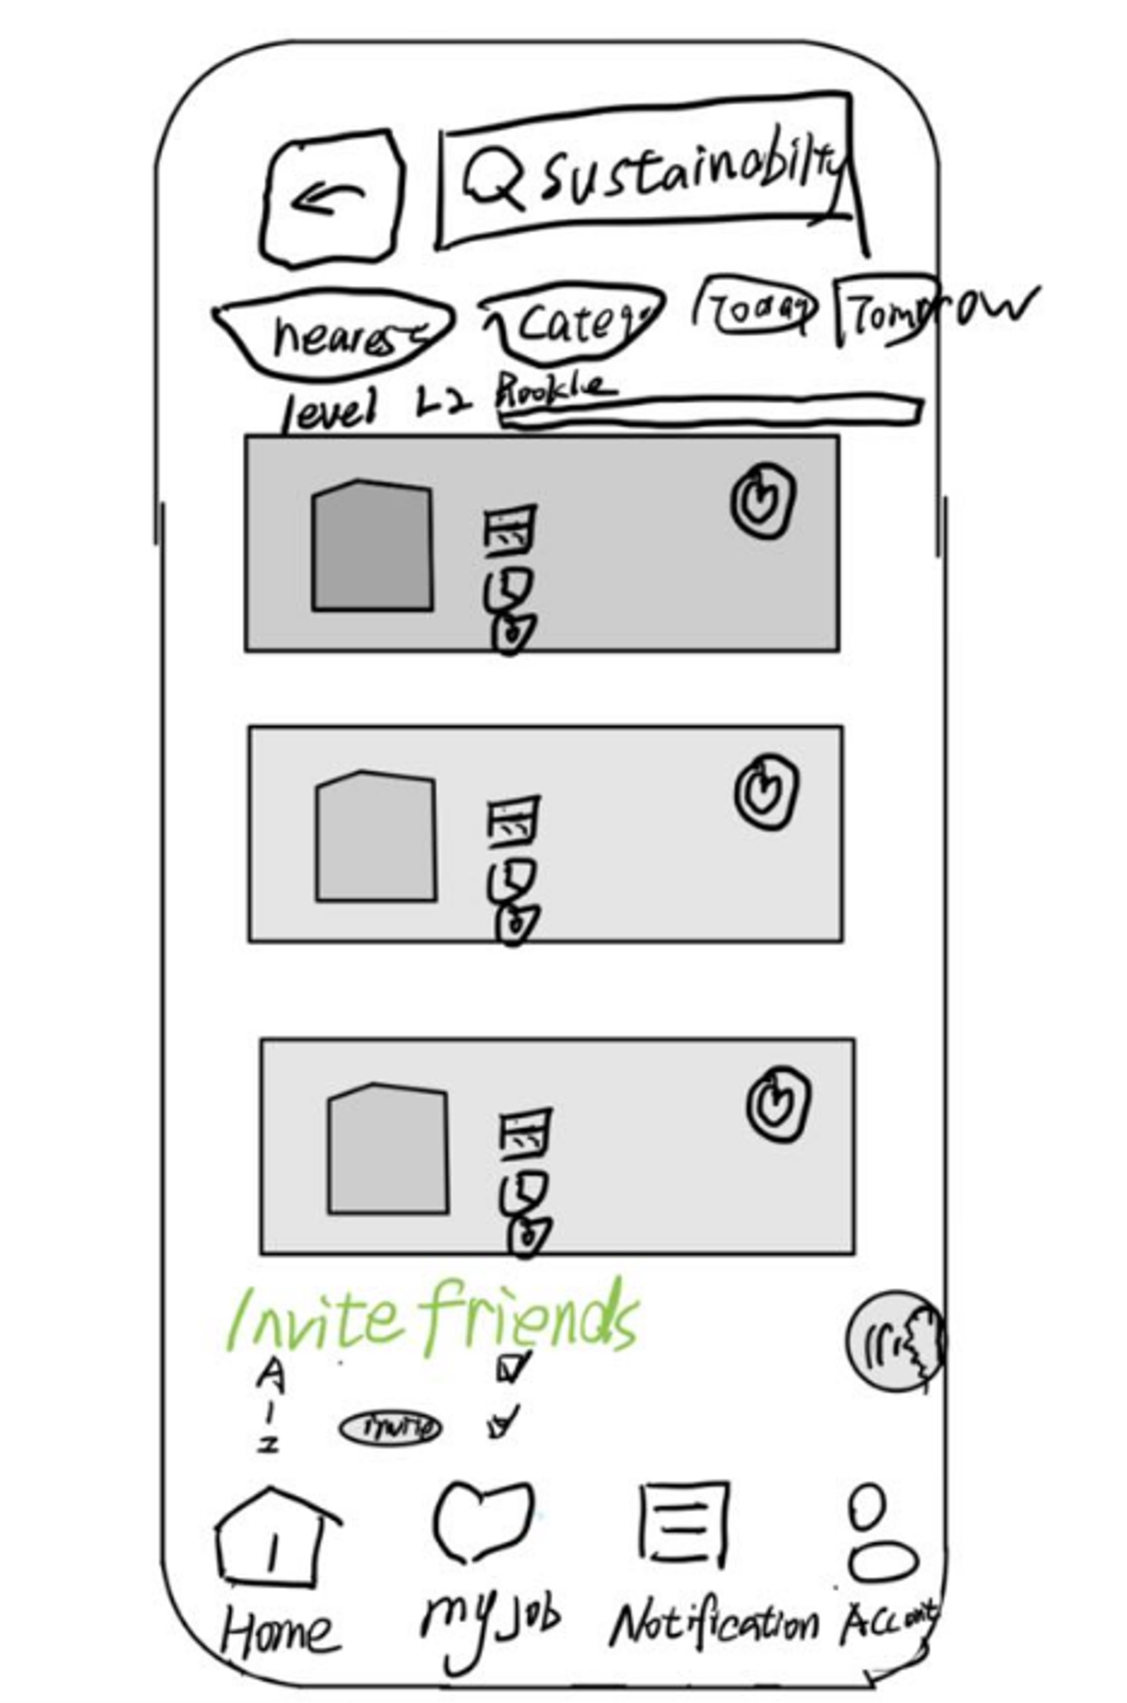
Apply for job and favourite (My Job)

Slide 11
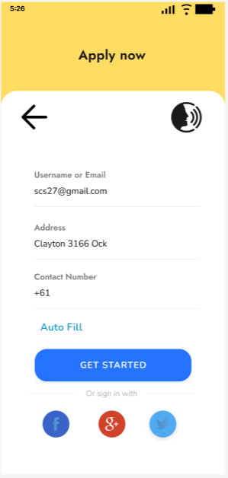
Visual Principles
Visual design elements: I pay attention to user experience and interface beauty, use lines, shapes, colors, layout, texture and space etc. elements to build the interface.
Visual design principles: ensure balanced distribution of elements across the screen, pay attention to contrast to highlight important objects, adjust scale to guide user attention, use hierarchical structure to organize content, maintain consistency in colors, shapes, fonts, and images.
Format principle: Use the format principle to group objects, enhance beauty and organize information. The five principles include proximity, similarity, common area, continuity, to enhance beauty and help users find information.

Slide 12
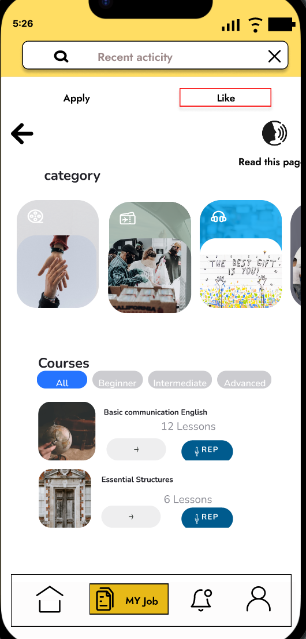
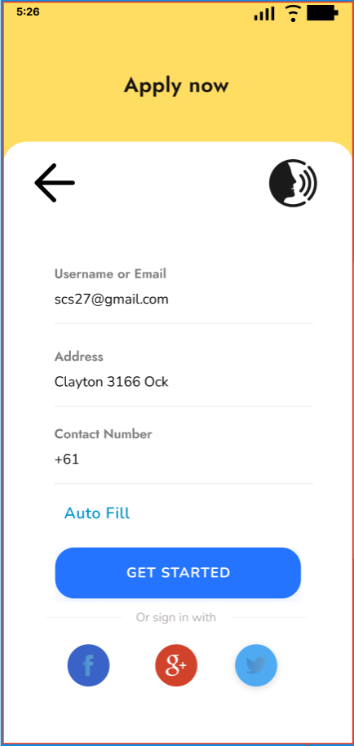
Accessibility guideline
Voice Auto-Reply: This feature enables voice responses for easier interaction and aligns with the principle of "providing multiple ways" under Web Content Accessibility Guidelines (WCAG). Ensure user-friendly activation and configuration to accommodate diverse users.
AutoFill: Simplify user experience by automatically populating previously entered personal information. It adheres to WCAG"Simplification and Consistency" principle. Ensure easy activation, management, and robust privacy safeguards for user data.

Slide 13
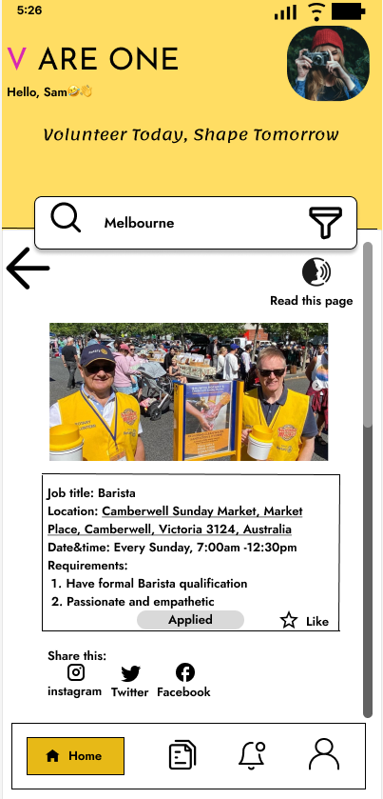
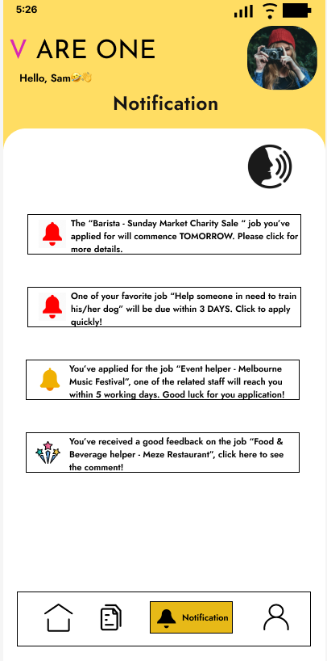
Notification and Account

Slide 14
Navigation and menu guidelines
Navigation: Utility
Navigation: Structural
Navigation: Associative
Menu: clear labels
Menu: grouping

Slide 15
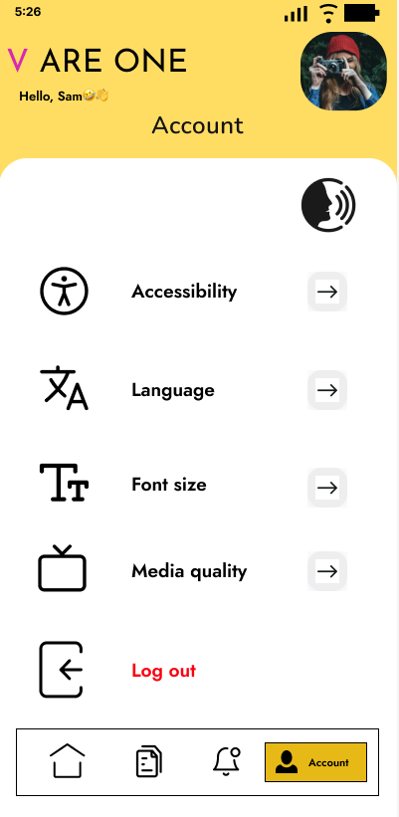
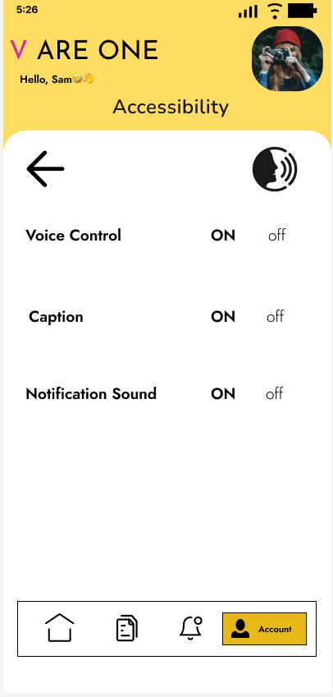
Accessibility guideline
WCAG principles: Operable
WCAG principles: Perceivable

Slide 16
Conclusion
Heuristic Evaluation (Nielsen's)
Visibility of System Status
Match between System and the Real World
User Control and Freedom
Consistency and Standards
Error Prevention
Recognition rather than Recall
Flexibility and Efficiency of Use
Aesthetic and Minimalist Design
Help Users Recognize, Diagnose, and Recover from Errors
Help and Documentation

Slide 17
Suggestion
Built-in Chat function - allow both parties to better understand each before applying
Rating function for both side (after the job finished)
Host to volunteer
Volunteer to host

